Slide 1
CS6135 VLSIPDA Global Placement
Yu-Hsiang Cheng
http://m105.nthu.edu.tw/~s105062901/Myweb/

Slide 2
Concept Part

Slide 3
Modern Placement Flow
Source: Y.-W. Chang

Slide 4
Analytical Placement Model
Lagrangian Relaxation
Source: Y.-W. Chang

Slide 5
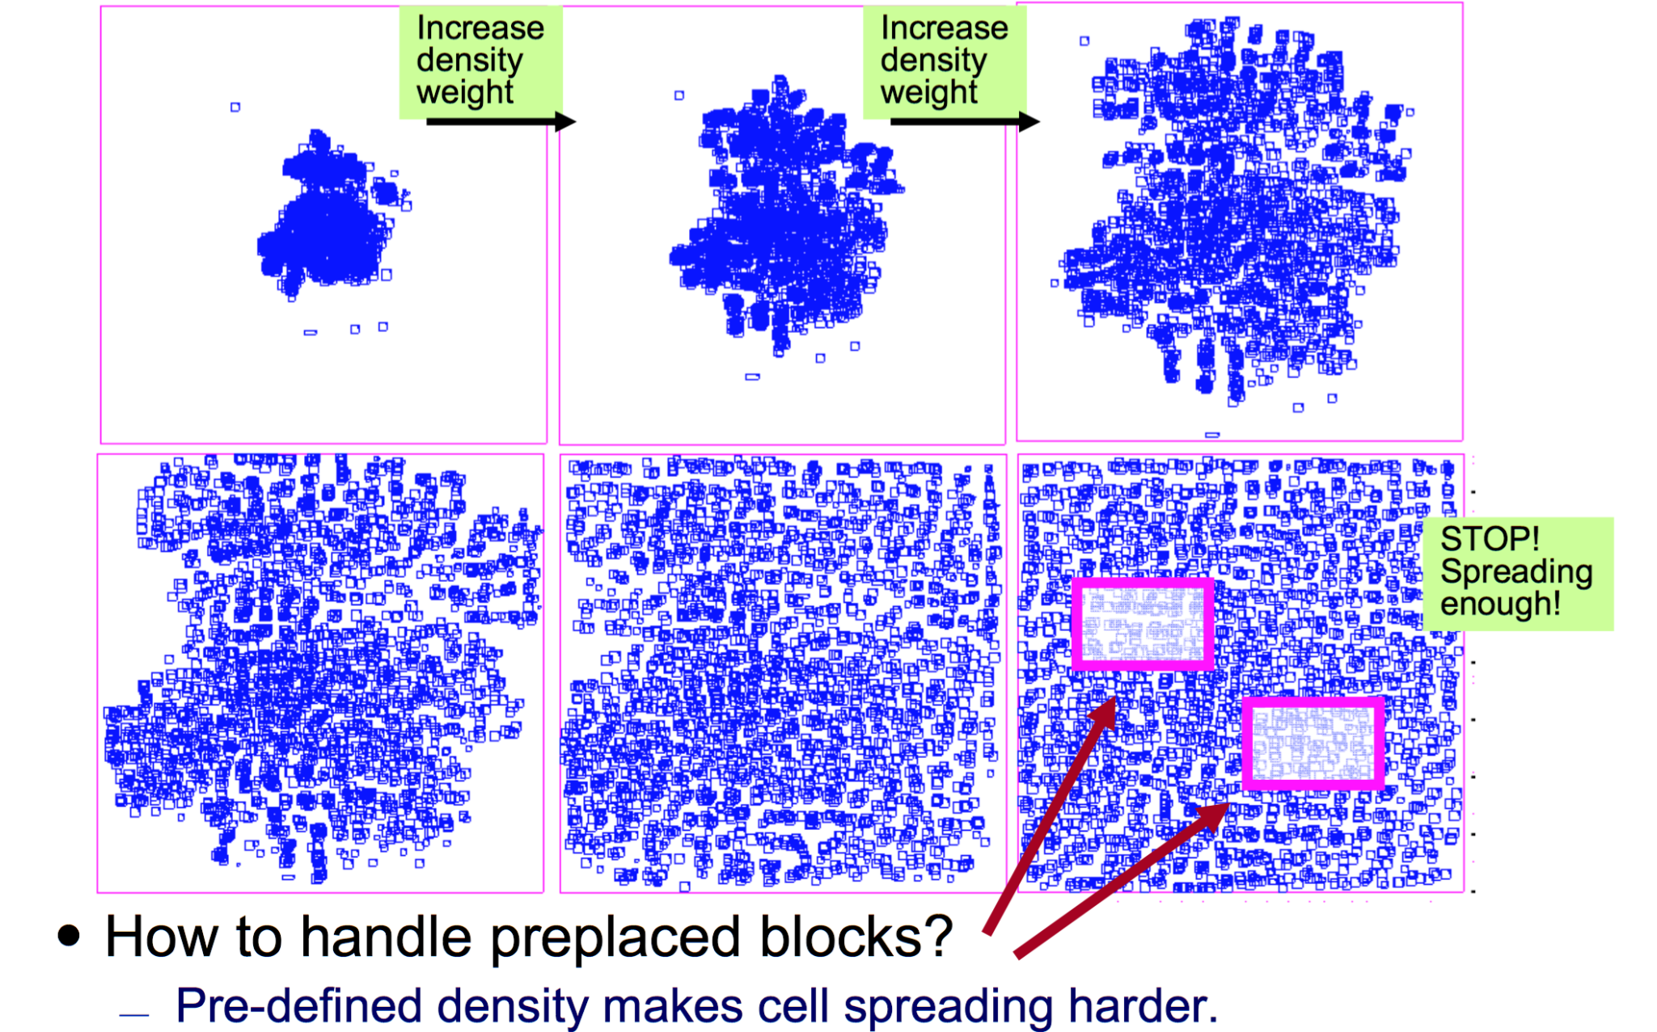
Cell Spreading During Global Placement
Source: Y.-W. Chang

Slide 6
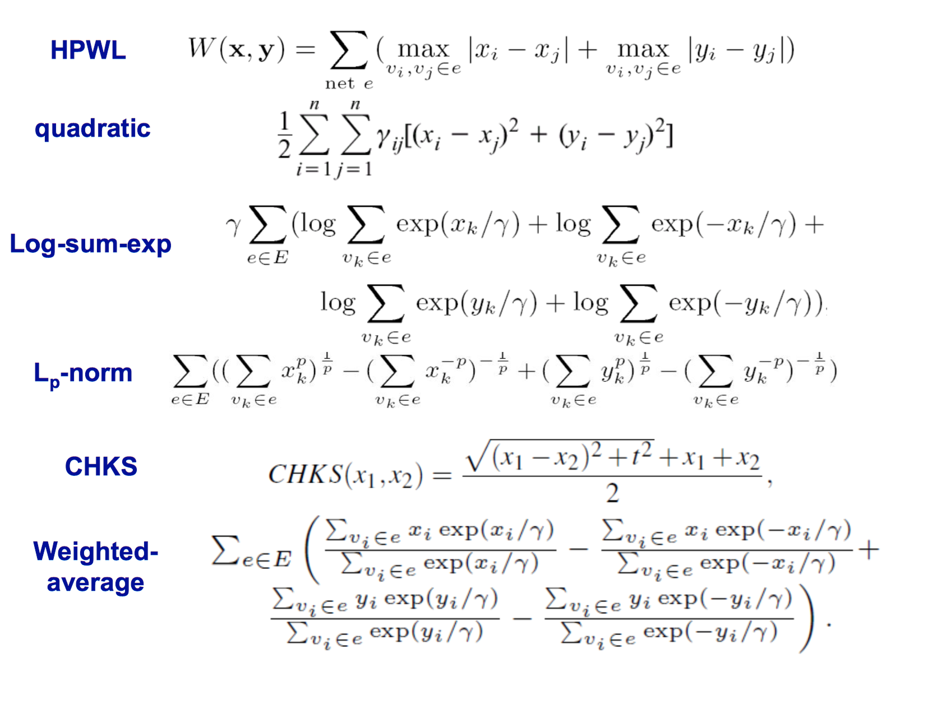
Popular Wirelength Models
Source: Y.-W. Chang

Slide 7
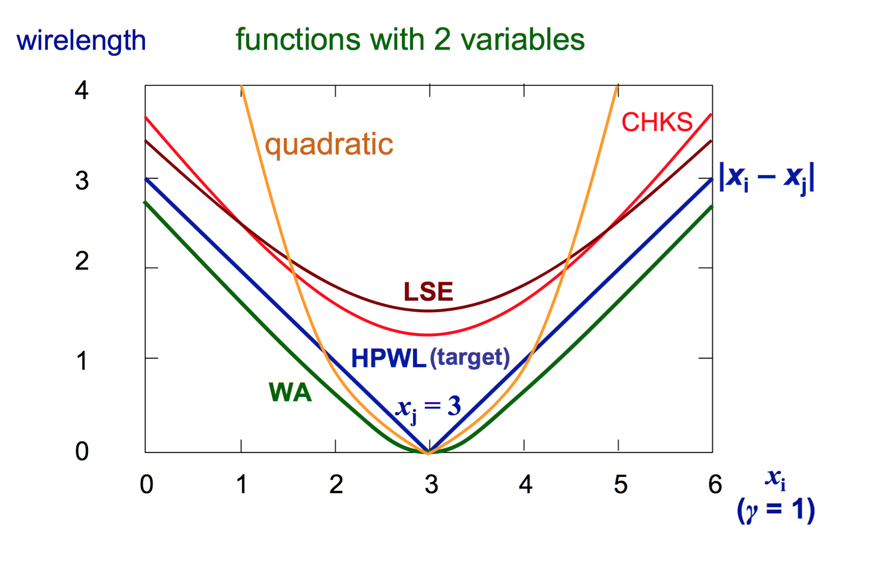
Popular Wirelength Model Comparisons
Source: Y.-W. Chang

Slide 8
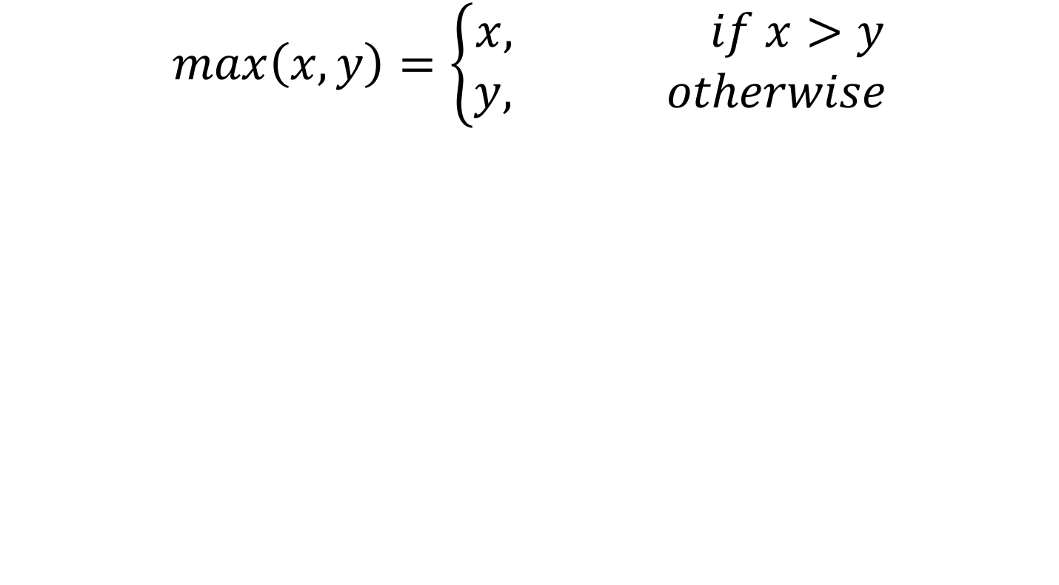
How to represent the max Function?
$$\max\left(x,y\right)=\left\{\begin{aligned}x, if x>y \\ y, otherwise\end{aligned}\right.$$

Slide 9
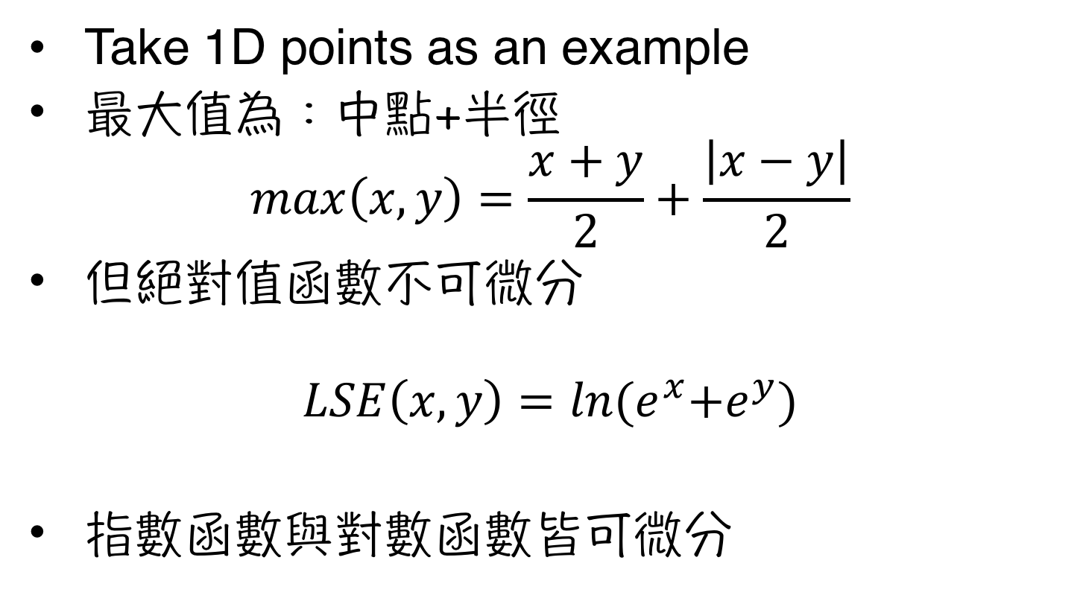
LogSumExp (LSE) vs. max (1/2)
Take 1D points as an example
最大值為：中點+半徑
$$max\left(x,y\right)=\frac{x+y}{2}+\frac{\left|x−y\right|}{2}$$
但絕對值函數不可微分
$$LSE\left(x,y\right)=\ln{{(e}^{x}+e^{y})}$$
指數函數與對數函數皆可微分

Slide 10
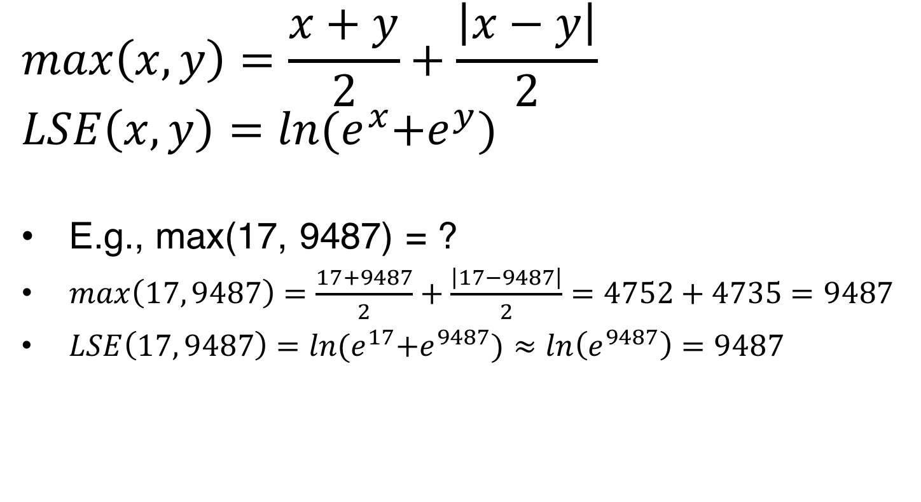
LogSumExp (LSE) vs. max (2/2)
$$max\left(x,y\right)=\frac{x+y}{2}+\frac{\left|x−y\right|}{2}$$
$$LSE\left(x, y\right)=\ln{{(e}^{x}+e^{y})}$$
E.g., max(17, 9487) = ?
$max\left(17, 9487\right)=\frac{17+9487}{2}+\frac{\left|17−9487\right|}{2}=4752+4735=9487$
$LSE\left(17, 9487\right)=\ln{{(e}^{17}+e^{9487})≈\ln\left(e^{9487}\right)=9487}$

Slide 11
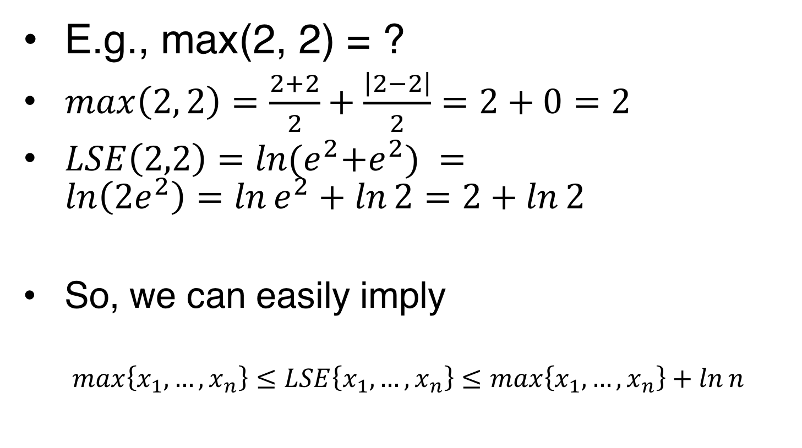
The Error Bounds of LSE
E.g., max(2, 2) = ?
$max\left(2, 2\right)=\frac{2+2}{2}+\frac{\left|2−2\right|}{2}=2+0=2$
$LSE\left(2,2\right)=\ln{{(e}^{2}+e^{2}) }=\ln\left(2e^{2}\right)=\ln{e^{2}}+\ln{2}=2+\ln{2}$
So, we can easily imply
$$\max\left\{x_{1},…,x_{n}\right\}≤LSE\left\{x_{1},…,x_{n}\right\}≤\max\left\{x_{1},…,x_{n}\right\}+\ln{n}$$

Slide 12
Popular Wirelength Model Comparisons
Source: Y.-W. Chang

Slide 13
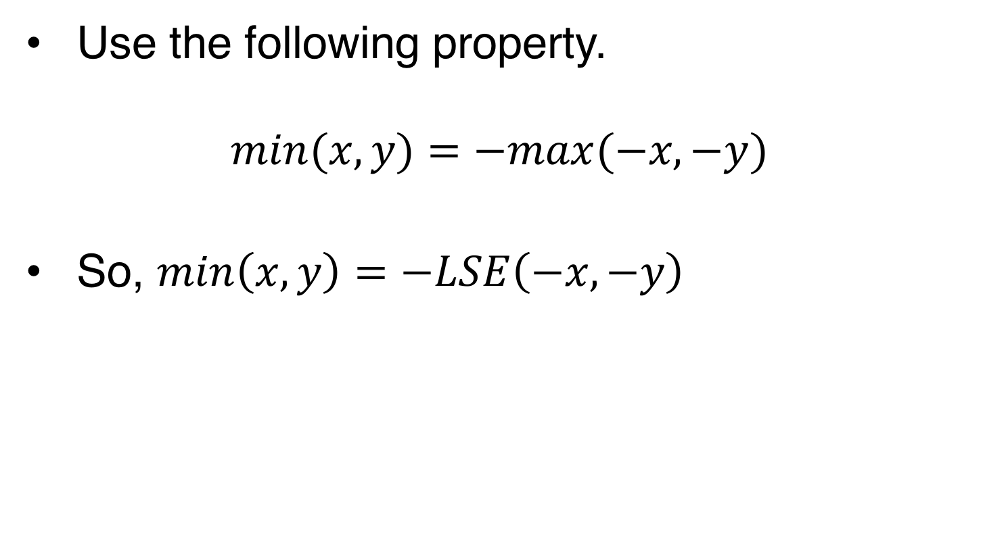
Use LSE to find min?
Use the following property.
$$min⁡(x,y)=−max⁡(−x,−y)$$
So, $\min\left(x,y\right)=−LSE\left(−x, −y\right)$

Slide 14
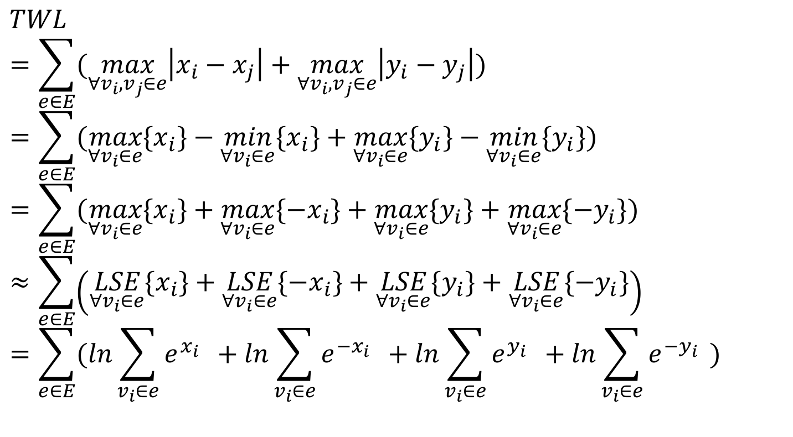
LSE Wirelength Model (1/2)
$$TWL$$
$$=\sum_{e∈E}{(\max_{∀v_{i},v_{j}∈e}\left|x_{i}−x_{j}\right|+\max_{∀v_{i},v_{j}∈e}\left|y_{i}−y_{j}\right|)}$$
$$=\sum_{e∈E}{(\max_{∀v_{i}∈e}{\{x_{i}\}}−\min_{∀v_{i}∈e}{\{x_{i}\}}+\max_{∀v_{i}∈e}{{\{y}_{i}\}}−\min_{∀v_{i}∈e}{{\{y}_{i}\}})}$$
$$=\sum_{e∈E}{(\max_{∀v_{i}∈e}{{\{x}_{i}\}}+\max_{∀v_{i}∈e}{{\{−x}_{i}\}}+\max_{∀v_{i}∈e}{{\{y}_{i}\}}+\max_{∀v_{i}∈e}{{\{−y}_{i}\}})}$$
$$≈\sum_{e∈E}{\left(\underset{∀v_{i}∈e}{LSE}{{\{x}_{i}\}}+\underset{∀v_{i}∈e}{LSE}{{\{−x}_{i}\}}+\underset{∀v_{i}∈e}{LSE}{{\{y}_{i}\}}+\underset{∀v_{i}∈e}{LSE}{{\{−y}_{i}\}}\right)}$$
$$=\sum_{e∈E}{(\ln_{ }\sum_{v_{i}∈e}{e^{x_{i}}}{ }+\ln_{ }\sum_{v_{i}∈e}{e^{{−x}_{i}}}{ }+\ln_{ }\sum_{v_{i}∈e}{e^{y_{i}}}{ }+\ln_{ }\sum_{v_{i}∈e}{e^{−y_{i}}}{ })}$$

Slide 15
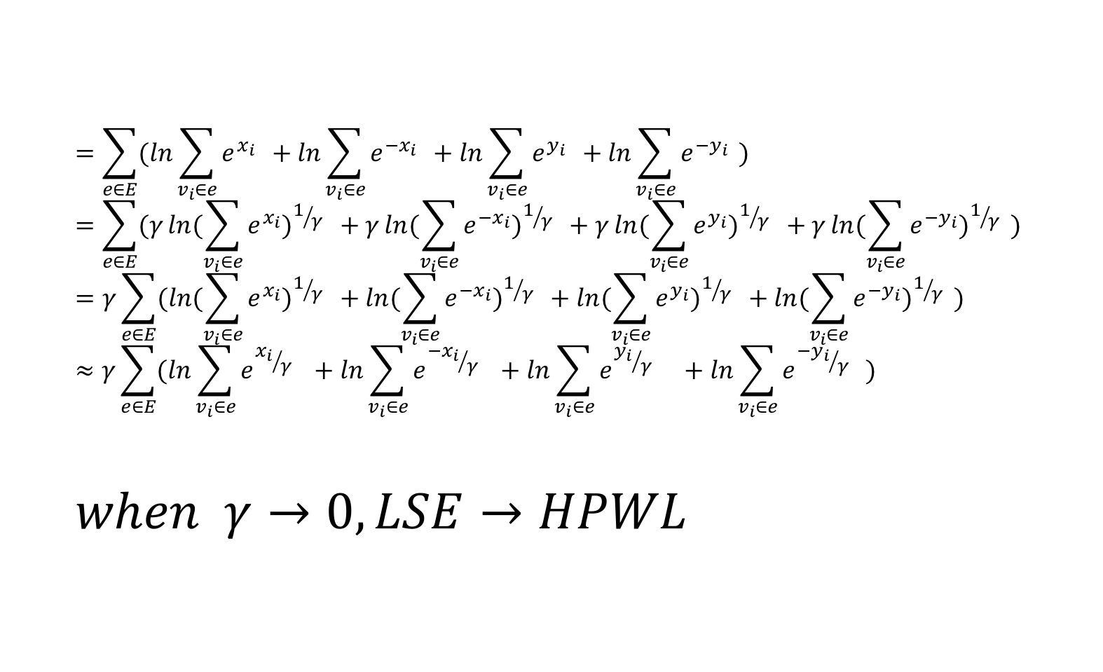
LSE Wirelength Model (2/2)
$$=\sum_{e∈E}{(\ln_{ }\sum_{v_{i}∈e}{e^{x_{i}}}{ }+\ln_{ }\sum_{v_{i}∈e}{e^{{−x}_{i}}}{ }+\ln_{ }\sum_{v_{i}∈e}{e^{y_{i}}}{ }+\ln_{ }\sum_{v_{i}∈e}{e^{−y_{i}}}{ })}$$
$$=\sum_{e∈E}{(γ\ln_{ }({\sum_{v_{i}∈e}{e^{x_{i}}})}^{1/γ}{ }+γ\ln_{ }({\sum_{v_{i}∈e}{e^{{−x}_{i}}})}^{1/γ}{ }+γ\ln_{ }({\sum_{v_{i}∈e}{e^{y_{i}}})}^{1/γ}{ }+γ\ln_{ }({\sum_{v_{i}∈e}{e^{{−y}_{i}}})}^{1/γ}{ })}$$
$$=γ\sum_{e∈E}{(\ln_{ }({\sum_{v_{i}∈e}{e^{x_{i}}})}^{1/γ}{ }+\ln_{ }({\sum_{v_{i}∈e}{e^{{−x}_{i}}})}^{1/γ}{ }+\ln_{ }({\sum_{v_{i}∈e}{e^{y_{i}}})}^{1/γ}{ }+\ln_{ }({\sum_{v_{i}∈e}{e^{{−y}_{i}}})}^{1/γ}{ })}$$
$$≈γ\sum_{e∈E}{(\ln_{ }{\sum_{v_{i}∈e}{e^{{x_{i}}/γ}}}^{ }{ }+\ln_{ }{\sum_{v_{i}∈e}{e^{{−x_{i}}/γ}}}^{ }{ }+\ln_{ }{\sum_{v_{i}∈e}{e^{{y_{i}}/γ}}}^{ }{ }{ }+\ln_{ }{\sum_{v_{i}∈e}{e^{{{−y}_{i}}/γ}}}^{ }{ })}$$
$$when γ→0, LSE→HPWL$$

Slide 16
Homework Part

Slide 17
Related Files
Global placement
May overlap with each other
./include/GlobalPlacer.h, ./GlobalPlacer.cpp (Global Placement)
./include/ExampleFunction.h, ./ExampleFunction.cpp (Objective function and its gradient)
./include/ NumericalOptimizer.h (Gradient solver)
…
Legalization
Resolve all overlaps
./include/TetrisLegal.h
./lib/libLegalizer.a
Detailed Placement
Further improve solution
./include/DPlace.h
./lib/libDetailPlace.a

Slide 18
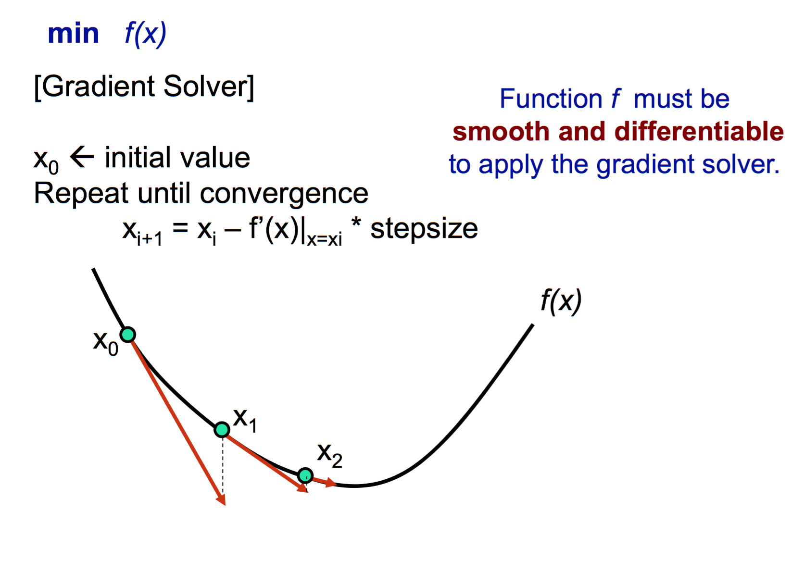
Gradient Solver
Source: Y.-W. Chang

Slide 19
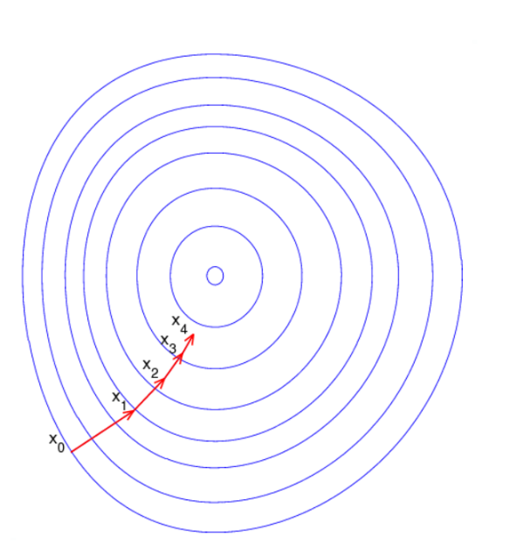
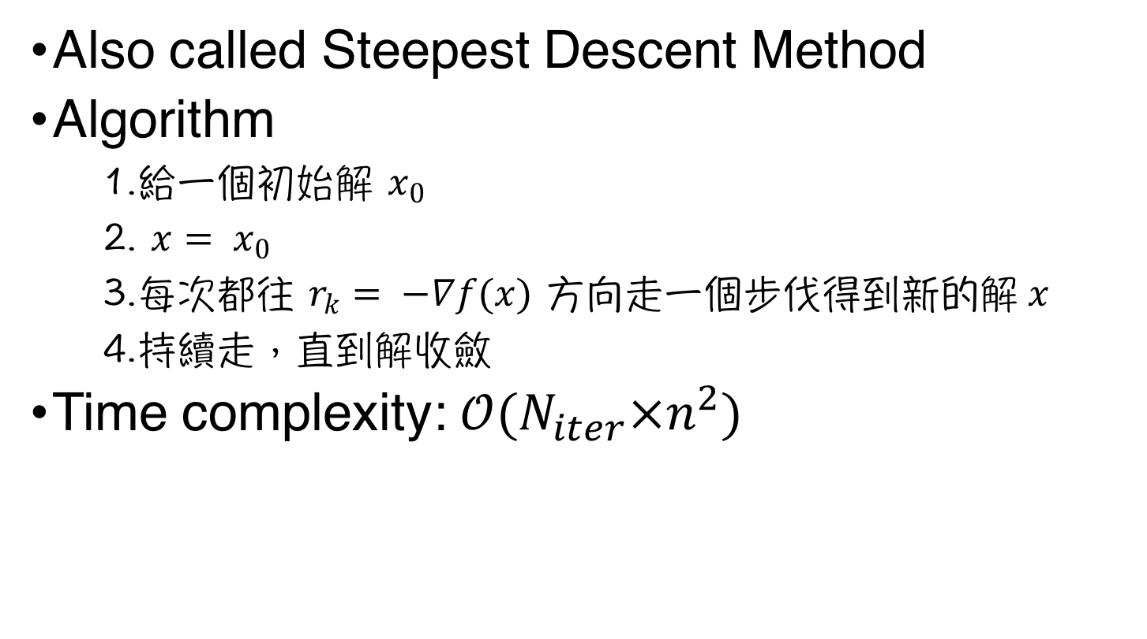
Gradient Descent Method (梯度下降法) (1/4)
Also called Steepest Descent Method
Algorithm
給一個初始解 $x_{0}$
$x= x_{0}$
每次都往 $r_{k}= −∇f(x)$ 方向走一個步伐得到新的解$x$
持續走，直到解收斂
Time complexity: $𝒪(N_{iter}×n^{2})$

Slide 20
Gradient Descent Method (梯度下降法) (2/4)

Slide 21
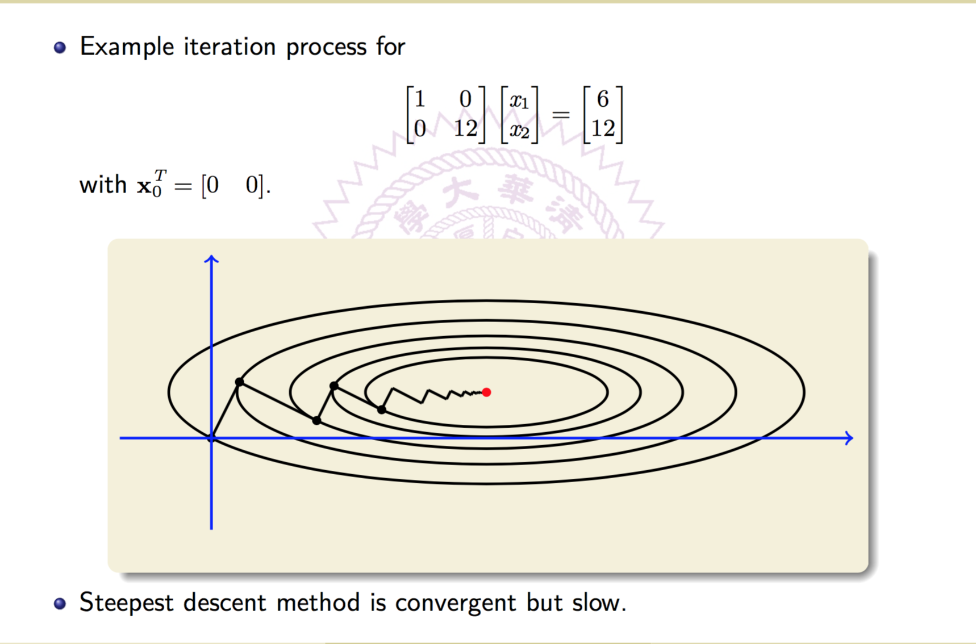
Gradient Descent Method (梯度下降法) (3/4)
Source: Mi-Chang, Chang

Slide 22
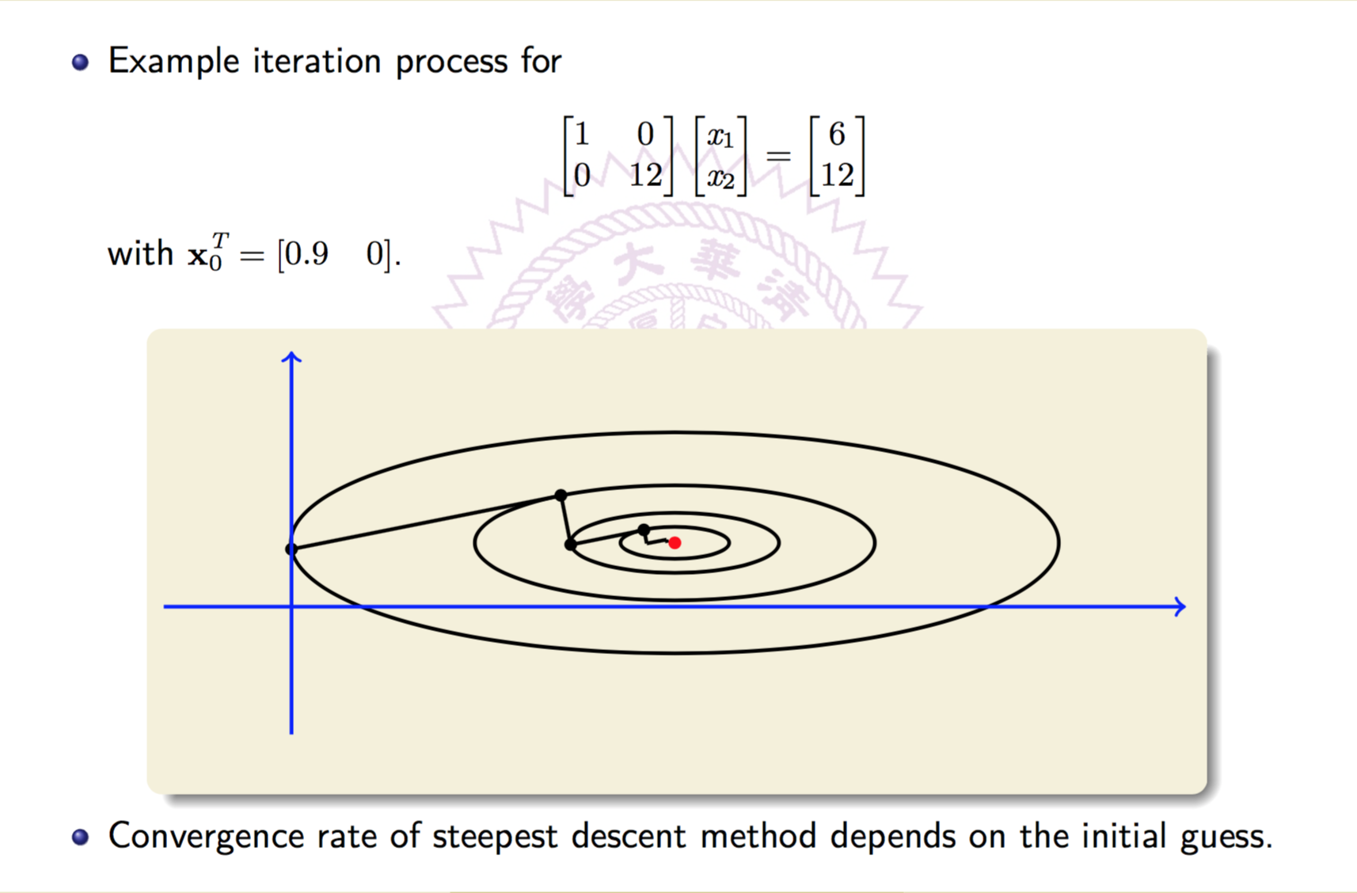
Gradient Descent Method (梯度下降法) (4/4)
Source: Mi-Chang, Chang

Slide 23
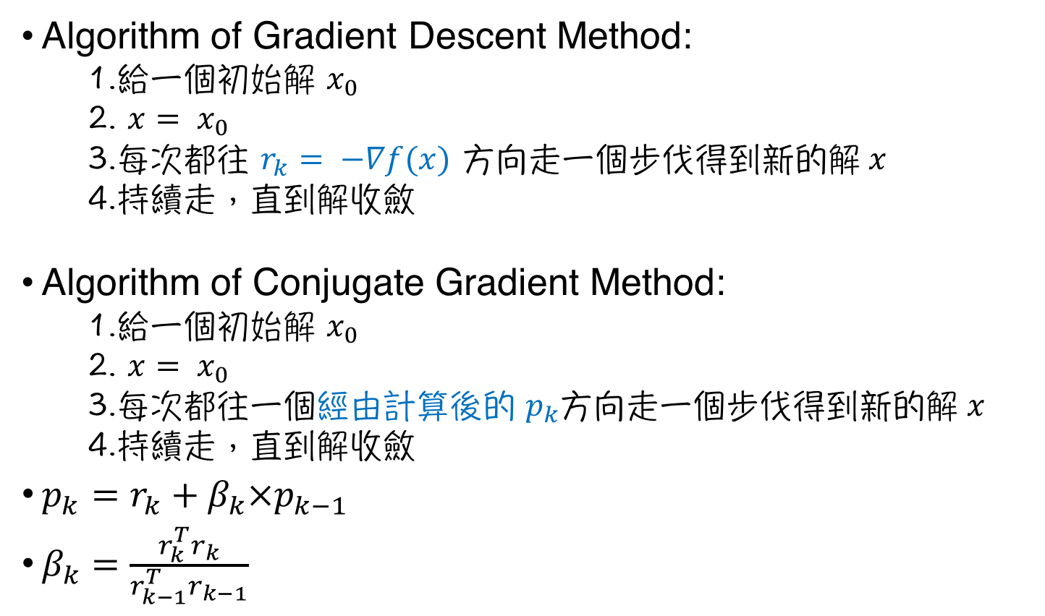
Conjugate Gradient Method (共軛梯度法) (1/3)
Algorithm of Gradient Descent Method:
給一個初始解 $x_{0}$
$x= x_{0}$
每次都往 $r_{k}= −∇f(x)$ 方向走一個步伐得到新的解$x$
持續走，直到解收斂
Algorithm of Conjugate Gradient Method:
給一個初始解 $x_{0}$
$x= x_{0}$
每次都往一個經由計算後的 $p_{k}$方向走一個步伐得到新的解$x$
持續走，直到解收斂
$p_{k}=r_{k}+β_{k}×p_{k−1}$
$β_{k}=\frac{r_{k}^{T}r_{k}}{r_{k−1}^{T}r_{k−1}}$

Slide 24
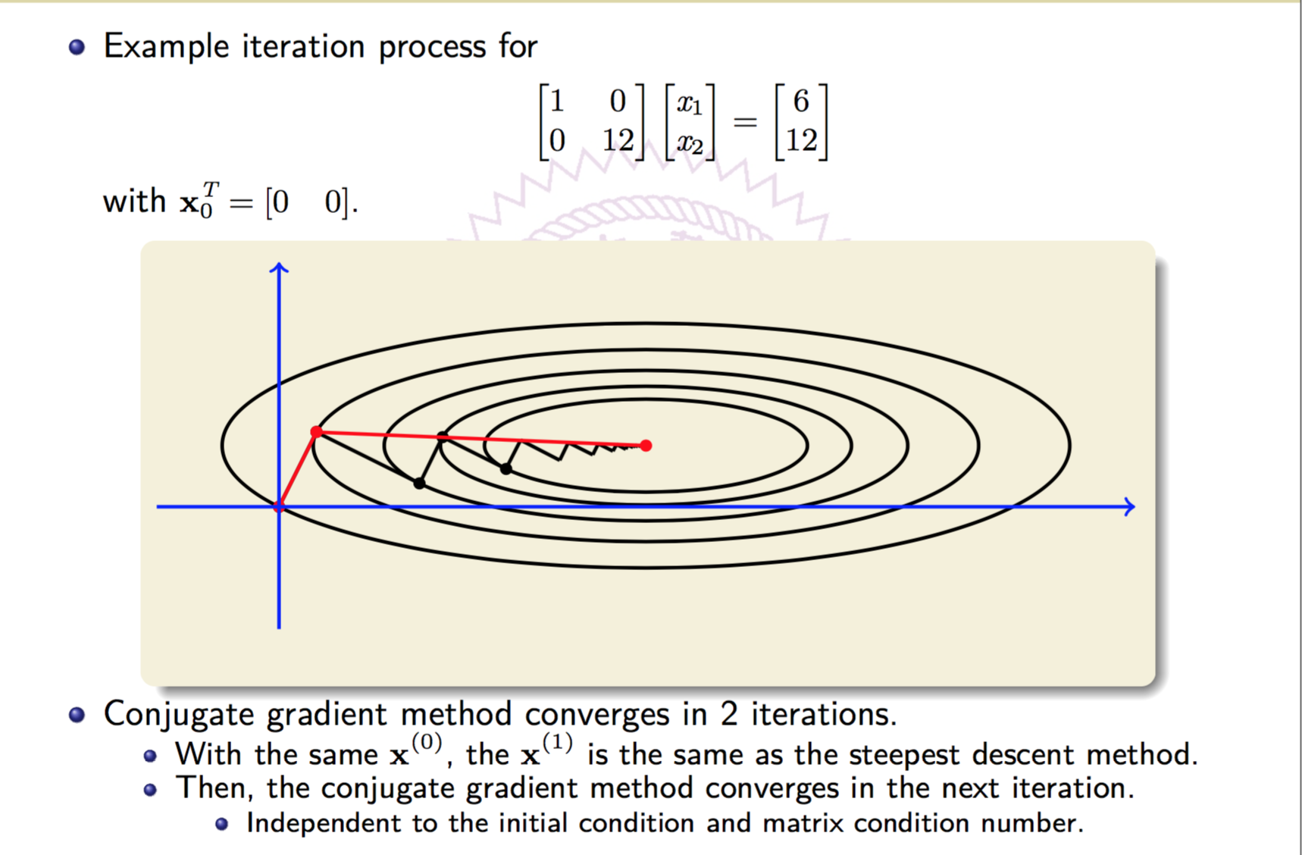
Conjugate Gradient Method (共軛梯度法) (2/3)
Source: Mi-Chang, Chang

Slide 25
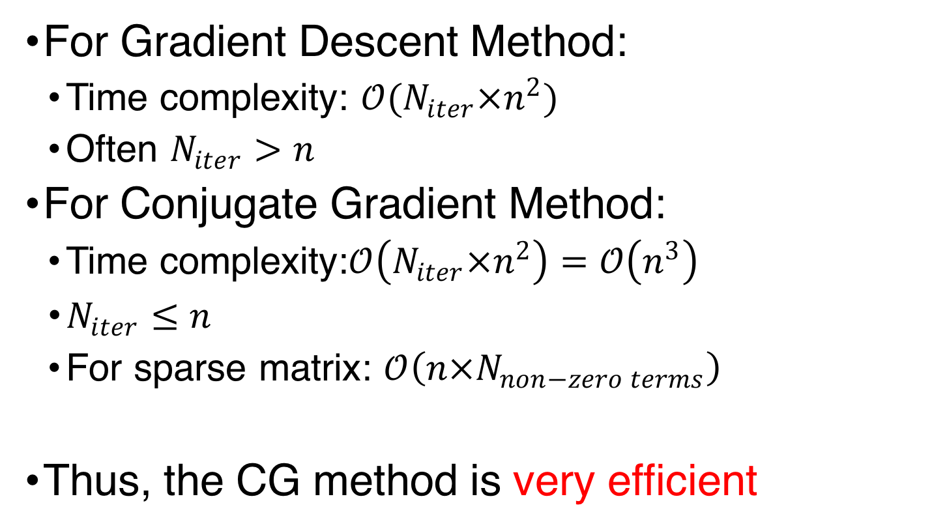
Conjugate Gradient Method (共軛梯度法) (3/3)
For Gradient Descent Method:
Time complexity: $𝒪(N_{iter}×n^{2})$
Often $N_{iter}>n$
For Conjugate Gradient Method:
Time complexity:$𝒪\left(N_{iter}×n^{2}\right)=𝒪\left(n^{3}\right)$
$N_{iter}≤n$
For sparse matrix: $𝒪\left(n×N_{non−zero terms}\right)$
Thus, the CG method is very efficient

Slide 26
HW4
$ unzip placement.zip
The gradient solver example is example.cpp
$ make example
$ ./example

Slide 27
Keys of Gradient Solver
Find a local minimum of a function
Objective function
Gradient functions
Initial vector
Number of Iterations
Tradeoff between quality and runtime
Step Size Bound
Too small: Require lots of iterations to converge
Too large: May even can not converge

Slide 28
Keys of Gradient Solver
Find a local minimum of a function
Objective function
Gradient functions
Initial vector
Number of Iterations
Tradeoff between quality and runtime
Step Size Bound
Too small: Require lots of iterations to converge
Too large: May even can not converge

Slide 29
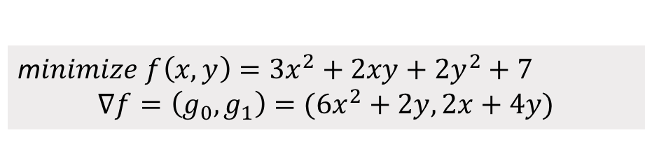
Example.cpp (1/5)
m$inimize f\left(x,y\right)=3x^{2}+2xy+2y^{2}+7$
$$∇f=\left(g_{0},g_{1}\right)=(6x^{2}+2y, 2x+4y)$$

Slide 30
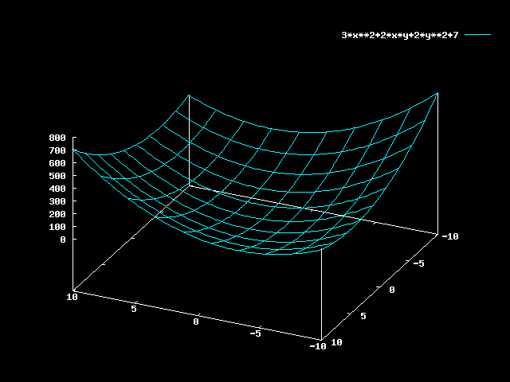
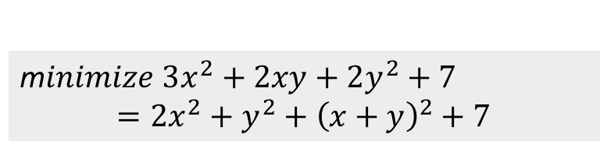
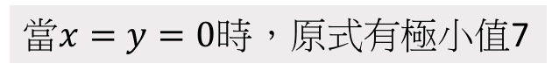
Example.cpp (2/5)
m$inimize 3x^{2}+2xy+2y^{2}+7$ $$=2x^{2}+y^{2}+{\left(x+y\right)}^{2}+7$$
當$x=y=0$時，原式有極小值7

Slide 31
Example.cpp (3/5)

Slide 32
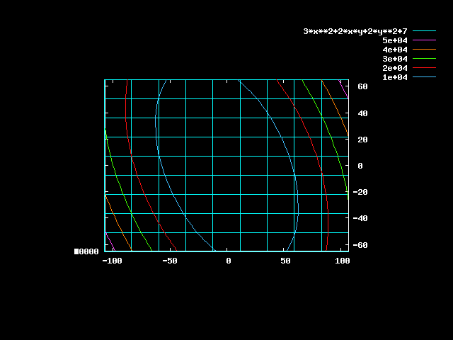
Example.cpp (4/5)
sdf

Slide 33
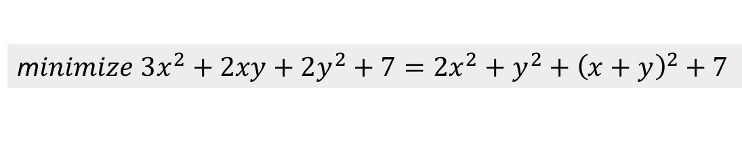

Example.cpp (5/5)
m$inimize 3x^{2}+2xy+2y^{2}+7=2x^{2}+y^{2}+{\left(x+y\right)}^{2}+7$
Objective function
Absolute value of gradient functions ($\sqrt{\sum_{i}{g_{i}^{2}}}$)
[vegetablebird@ic28 placement]$ ./place -aux benchmark/ibm01/ibm01-cu85.aux
Objective = 65097 ||grad|| = 1000
Objective = 60367 ||grad|| = 964.002
Objective = 55816.9 ||grad|| = 928.013
………
Objective = 7.00378 ||grad|| = 0.305804
Objective = 7.00193 ||grad|| = 0.184733
Current solution:
x[0] = 0.000796515
x[1] = 0.0306817
Objective: 7.00193
[vegetablebird@ic28 placement]$
Iterations
Final solution

Slide 34
Keys of Gradient Solver
Find a local minimum of a function
Objective function
Gradient functions
Initial vector
Number of Iterations
Tradeoff between quality and runtime
Step Size Bound
Too small: Require lots of iterations to converge
Too large: May even can not converge

Slide 35
Example.cpp

Slide 36
Todo (1/5)
You can refer to GlobalPlacee::randomPlace() implemented by TA

Slide 37
Todo (2/5)
First, just directly,
$ make
$ ./place -aux benchmark/ibm01/ibm01-cu85.aux
You will see the following message
---------------------*******************legalization fail!
HPWL: 212729459 (3505.91%)
on the screen

Slide 38
Todo (3/5)
Second, in GlobalPlace.cpp, uncomment line 53 and 54. Then, remake and re-execute again
You will see the following message
////// Legalization ///////
macro size: 0
legalization success!
HPWL: 682968121 (-6.11%)
on the screen

Slide 39
Todo (4/5)
Follow the hints in GlobalPlace::place()

Slide 40
Todo (5/5)
Modify place() in GlobalPlacer.cpp
The upper part is an example which is the same as example.cpp
Modify evaluateFG(), dimension(), evaluateG(),… in ExampleFunction.cpp
This homework tests the following abilities
Calculus (if you use analytical approaches)
Code Reading

